Slide 1

AOLME Curriculum SESSION 3
MATERIALS DEVELOPED BY THE AOLME PROJECT AT THE UNIVERSITY OF NEW MEXICO, PLEASE DO NOT COPY OR DISTRIBUTE ANY OF THESE COPYRIGHTED TASKS WITHOUT PROPER AUTHORIZATION

Slide 2


Level 1
SESSION 1: Basic of Raspberry PI and Linux-(motivational overview of projects-images, ls, cd) SESSION 2: Introduction to Python Programming (print, algebra, strings) SESSION 3: Algorithms: Loops, Conditionals, and Sequential Thinking (for and while loops, range commands, if statements, inequalities, sprite movement) SESSION 4: The Coordinate Plane and Black & White Images in Python SESSION 5: Binary and Hexadecimal number systems SESSION 6: Images and Their Components (histograms) SESSION 7: Creation of Images and Video FINAL PROJECT: VIDEO

Slide 3
Loops, Conditionals, & Sequential Thinking
OBJECTIVES:
Introduce students to the notion and relevance of loops, conditionals and sequential thinking in programming.
Understand the link between algorithms and mathematics.
Practice pseudocodes through sequential thinking.

Slide 4

Selected ACTIVITIES
1. Using Loops to Create Number Sequences
2. Guessing Numbers: Using Loops & Conditionals
3. Moving AOLME Sprite w/ Python IDLE

Slide 5


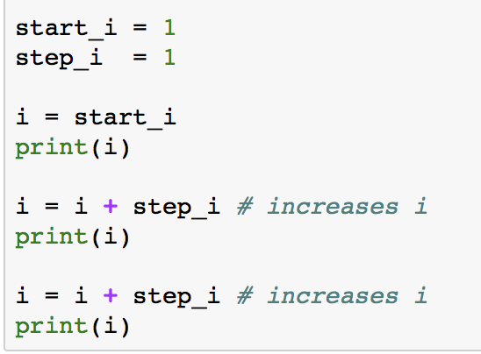

3.1. Using for Loops to Count
Note: The numbers in the Card match the Tasks numbers in the Jupyter Notebook.
Go to the terminal to open Jupyter:
type jupyter notebook
click enter
go to the directory/home/pi/AOLME/Session 3/
open the file : Session 3-Loops
2. Run & Analyze: In CELLs A, B, and C there is some Python code. Pay attention to the code in each cell and run them. What happens when you run each CELL? When you change some of the numbers in the code and run it, what happens?
In CELL B, what if you changed step_i value to 5?
Once in this file, note that under title of activity 3.1, there are 3 CELLS: A, B, C
What differences do you notice between CELLS C and A & B?
Use comments in the CELLs as a guide.
3. Think & Create: Now it’s your time to show what you’ve learned. In PRACTICE CELLs A, B, and C type in the codes and run them to see how you are completing the challenge. A little typo can be an issue for the code not to run.
4. Discuss & Write: Based on the tasks you’ve done, discuss in your team: What is a for loop?
Analyze the for loop statement below that we used. What parts of the statement could be changed, what words?
for i in range(start_i, stop_i, step_i):
When a code is entered in the right order and without typos or errors, then your code syntax is good and the code will run. What’s syntax?
Talk about the syntax of this code: fox i in range 4):
Write down in your journal what you’ve learned.
AOLME PROJECT - LEVEL 1- SESSION 3- 2019
MATERIALS DEVELOPED BY THE AOLME PROJECT AT THE UNIVERSITY OF NEW MEXICO, PLEASE DO NOT COPY OR DISTRIBUTE ANY OF THESE COPYRIGHTED TASKS WITHOUT PROPER AUTHORIZATION

Slide 6

3.1. Using for Loops to Create Number Sequences
Resources for the Activity
Recommended Steps for the Activity
Activity Card
Folder: /home/pi/AOLME/Session 3/
the “jupyter” notebook accessed via Terminal
Raspberry Pi and Monitor
Student journal
Make sure that students use own words to define loop and how they see it working in computer programming.
Have students work with different cells and compare the code across.
When playing with numbers have students come up with own examples too.
Have students debrief what they learned by experimenting and have them write notes in journal.
Everyone in the team gets to play a role:
Discussion Expert: Leads the team discussion asking questions about what the session is about.
Fair Participation Expert: makes sure of fair participation of everyone.
Hardware Setup/Teardown Expert: in charge of setting up & putting away materials and computer equipment.
Summary Expert: summarizes and records team questions and what the teams has learned.
Activity 1 Goal: Introduce students to the notion and relevance of loops, conditionals and sequential thinking in programming.
AOLME PROJECT - LEVEL 1- SESSION 3- 2018
MATERIALS DEVELOPED BY THE AOLME PROJECT AT THE UNIVERSITY OF NEW MEXICO, PLEASE DO NOT COPY OR DISTRIBUTE ANY OF THESE COPYRIGHTED TASKS WITHOUT PROPER AUTHORIZATION

Slide 7
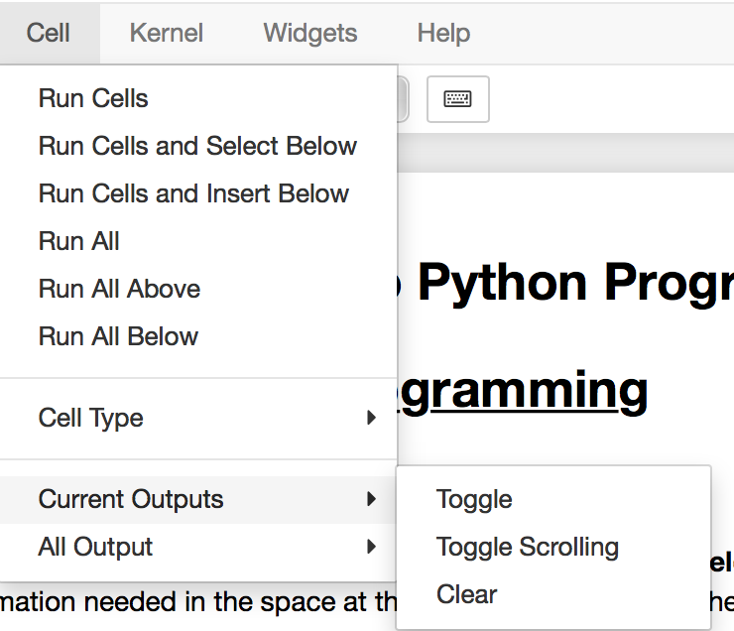
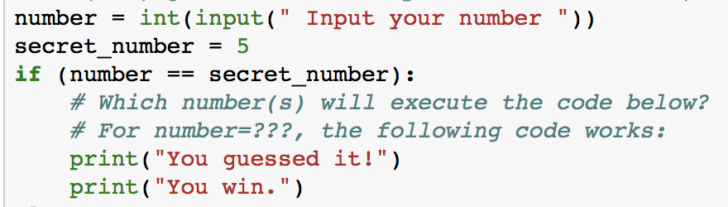


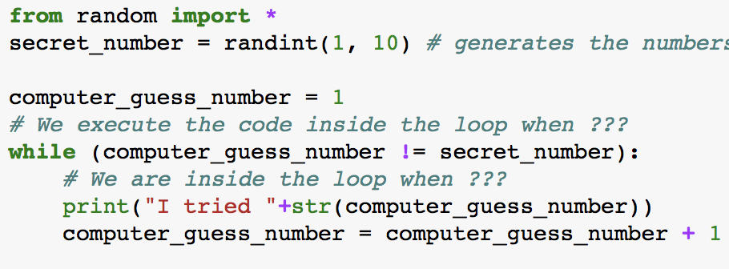
3.2. Guessing Numbers: Using Loops & Conditionals
Note: The numbers in the Card match the Tasks numbers in the Jupyter Notebook.
1. To program the game, we need conditional statements. Computers understand conditions. For example, if x = 5, then stop counting. How do we know it is a condition? Do your math teachers give you conditions? How are the conditions in CELLS similar or different from each other?
2. Clear CELLS to enter new values or numbers. Remember how to clear CELLS in jupyter?
In the code, where’s the ‘condition’?
Also, always save your work!!
Run: CELLS A & B to explore conditions. Try out different numbers.
Clear cell results by following these steps. Or click on run again:
What do strings do here?
Run & Compare: What happens in CELLs 3.A and 3.B? Why?
3.A.while(0): 3.B. while(1==2):
print(1) print(1)
Change 2 to 1. What happens? Why?
It’s called an infinite loop. What’s the condition in the loop?
4. Design: In CELL E create your game. Change the code as you need. Plan the steps to play the game.
If your code runs forever, press stop
Think & Compare:
How are these statement different? What do they do?
-for i in range(start_i, stop_i, step_i):
-if (number = = secret_number):
-while (number != secret_number):
Run and change values in CELLs C and D.
Which of these ideas can you use in your game?
!= means not equal
Why is it useful here?
Think: what code will help you create your game?
AOLME PROJECT - LEVEL 1- SESSION 3- 2019
MATERIALS DEVELOPED BY THE AOLME PROJECT AT THE UNIVERSITY OF NEW MEXICO, PLEASE DO NOT COPY OR DISTRIBUTE ANY OF THESE COPYRIGHTED TASKS WITHOUT PROPER AUTHORIZATION

Slide 8
3.2. Guessing Numbers: Using Loops & Conditionals
Resources for the Activity
Recommended steps for the Activity
Make sure that students understand the conceptual understanding of loops and conditionals (if) as they ‘play’ with the code.
When running each cell, make sure to have them predict and then try to identify what each code lines does. Perhaps changing numbers can help figure out better what the codes do.
Contrast what codes do across cells.
Discuss how the order of operations, grouping and definitions of variables might help solving a problem.
Activity Card
the “Jupyter” notebook accessed via Terminal
Folder: /pi/AOLME/Session 3/
Raspberry Pi and Monitor
Student journal
Everyone in the team gets to play a role:
Discussion Expert: Leads the team discussion asking questions about what the session is about.
Fair Participation Expert: makes sure of fair participation of everyone.
Hardware Setup/Teardown Expert: in charge of setting up & putting away materials and computer equipment.
Summary Expert: summarizes and records team questions and what the teams has learned.
Activity 2 Goal: Understand the link between algorithms and mathematics.
AOLME PROJECT - LEVEL 1- SESSION 3- 2018
MATERIALS DEVELOPED BY THE AOLME PROJECT AT THE UNIVERSITY OF NEW MEXICO, PLEASE DO NOT COPY OR DISTRIBUTE ANY OF THESE COPYRIGHTED TASKS WITHOUT PROPER AUTHORIZATION

Slide 9
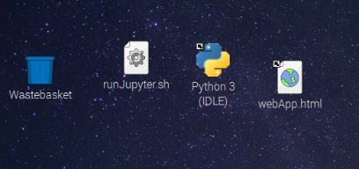
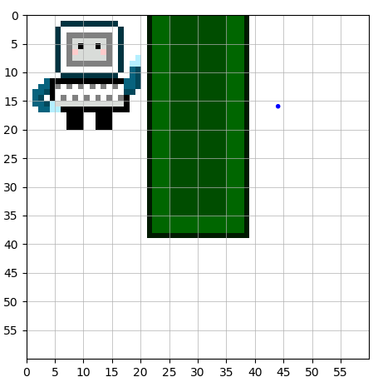
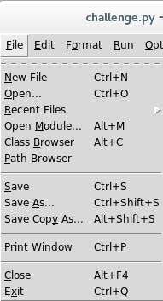

3.3. Moving the AOLME Sprite with Python IDLE
END
Think & Plan: AOLME wants to go around the park. Can you help him? Think: How much and in what directions will AOLME need to move to go around the park?
Think & make a plan..
2. To access AOLME game:
-Click on Python IDLE icon.
-In IDLE top bar, click on File.
-Select Open and navigate to /home/pi/AOLME/Session3/
-Open the file: game.py
-Run the code by pressing F5
START
Also run code by pressing
Always save your work.
3. Think & Program: Below there are codes for you to use and help AOLME go around the park.
4. Write: In your team discuss what you learned in session 3 and write main ideas of what you learned about programming loops, conditional statements, etc.
Why do we need this line?
from AOLME_game import *
I <3 walking!
scene.block_move_sprite_down('aolme')
scene.block_move_sprite_right('aolme')
scene.block_move_sprite_up('aolme')
scene.block_move_sprite_left('aolme')
These commands help AOLME move. Which ones will you use?
Here are some ideas to write about:
-for i in range(start_i, stop_i, step_i):
-if (number = = secret_number):
-while (number != secret_number):
Use cards 3.1. & 3.2 to remember.
show = scene.play_game()
Last line shows the scene.
AOLME PROJECT - LEVEL 1- SESSION 3- 2019
MATERIALS DEVELOPED BY THE AOLME PROJECT AT THE UNIVERSITY OF NEW MEXICO, PLEASE DO NOT COPY OR DISTRIBUTE ANY OF THESE COPYRIGHTED TASKS WITHOUT PROPER AUTHORIZATION

Slide 10
3.3. Moving AOLME Sprite with Python IDLE
Resources for the Activity
Recommended steps for the Activity
Have students reflect on how much and in what direction AOLME needs to move.
Make sure students ‘play’ with the code
Let students copy and paste codes for moves. The goal is to think with the codes.
Try not to tell them, instead ask questions to prompt their thinking.
Have students debrief and write about what they learned in session 3
Activity Card
Folder: /home/pi/AOLME/Session3/ and file: game.py
the “Jupyter” notebook accessed via Terminal
Raspberry Pi kit
Student journal
Evaluate how did the team roles work?
Discussion Expert: Leads the team discussion asking questions about what the session is about.
Fair Participation Expert: makes sure of fair participation of everyone.
Hardware Setup/Teardown Expert: in charge of setting up & putting away materials and computer equipment.
Summary Expert: summarizes and records team questions and what the teams has learned.
Activity 3 Goal: Practice pseudocodes through sequential thinking.
AOLME PROJECT - LEVEL 1- SESSION 3- 2018
MATERIALS DEVELOPED BY THE AOLME PROJECT AT THE UNIVERSITY OF NEW MEXICO, PLEASE DO NOT COPY OR DISTRIBUTE ANY OF THESE COPYRIGHTED TASKS WITHOUT PROPER AUTHORIZATION

